Slide 1

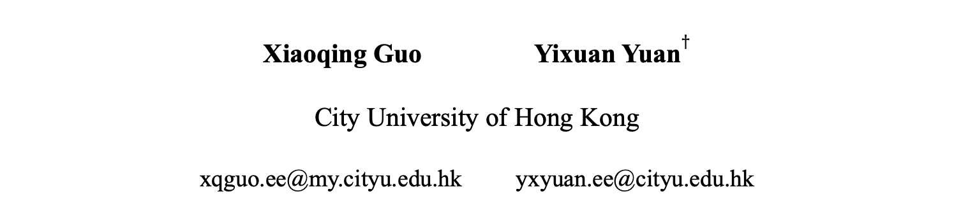
Joint Class-Affinity Loss Correction for Robust Medical Image Segmentation with Noisy Labels
Xiaoqing Guo Yixuan Yuan$†$
City University of Hong Kong
xqguo.ee@my.cityu.edu.hk yxyuan.ee@cityu.edu.hk
† Yixuan Yuan is the corresponding author
[Guo and Yuan MICCAI 2022]
Notes:
Welcome to our presentation. Here I am presenting ‘Joint Class-Affinity Loss Correction for Robust Medical Image Segmentation with Noisy Labels’.

Slide 2
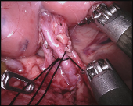
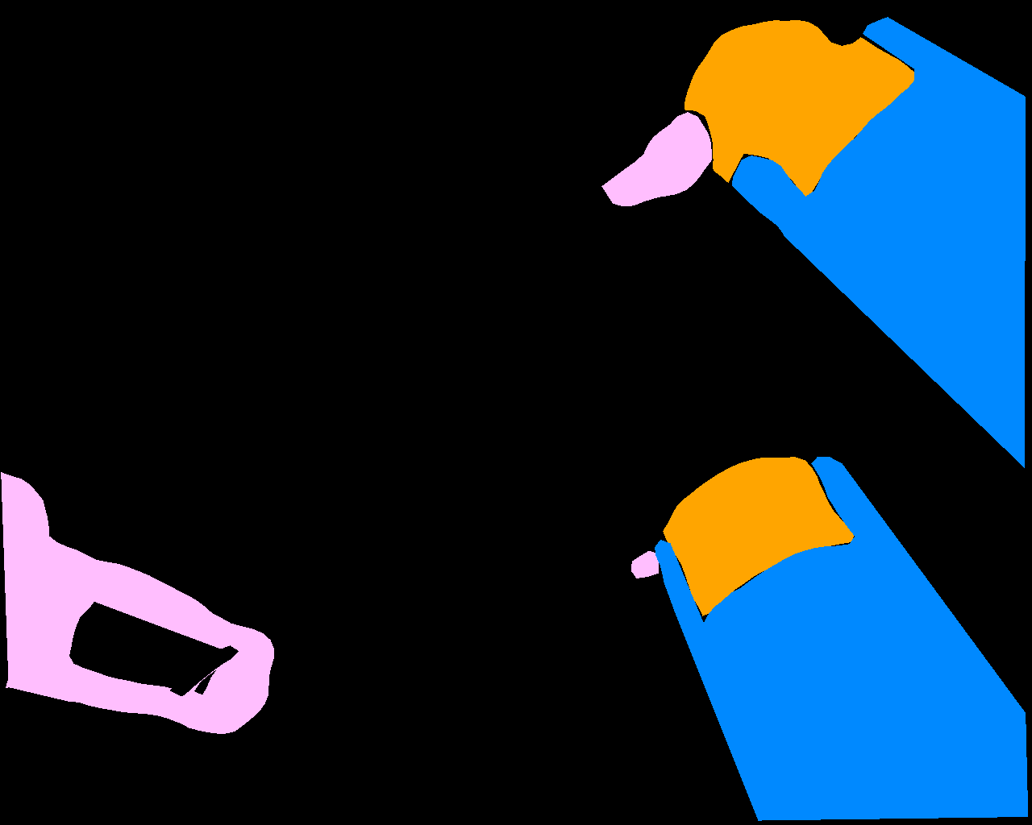
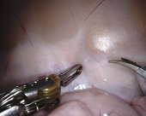
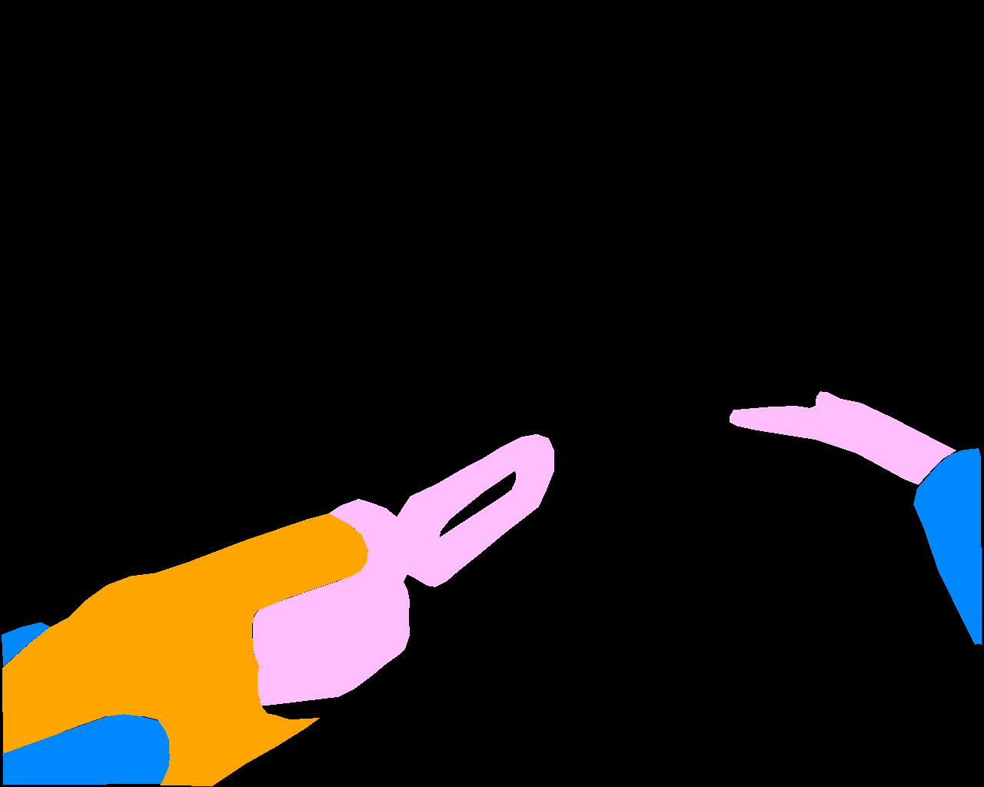
Introduction
Background:
Image
Ground truth
Notes:
In medical image segmentation, acquiring high-quality pixel-level annotations is often difficult and expensive.

Slide 3

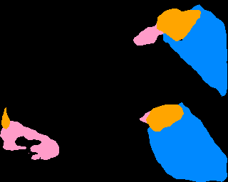


Introduction
Background:
Image
Ground truth
Week label
SFDA label
SFDA: source-free domain adaptation
Notes:
With limited budgets and efforts, the resulting annotated datasets would contain lots of label noises, leading to severely degraded generalizability. Hence, developing medical image segmentation models that are robust to noisy labels in training data is of great importance.

Slide 4
Introduction
Existing approaches:
Notes:
Previous solutions for medical image segmentation with noisy labels can be summarized into three aspects.

Slide 5
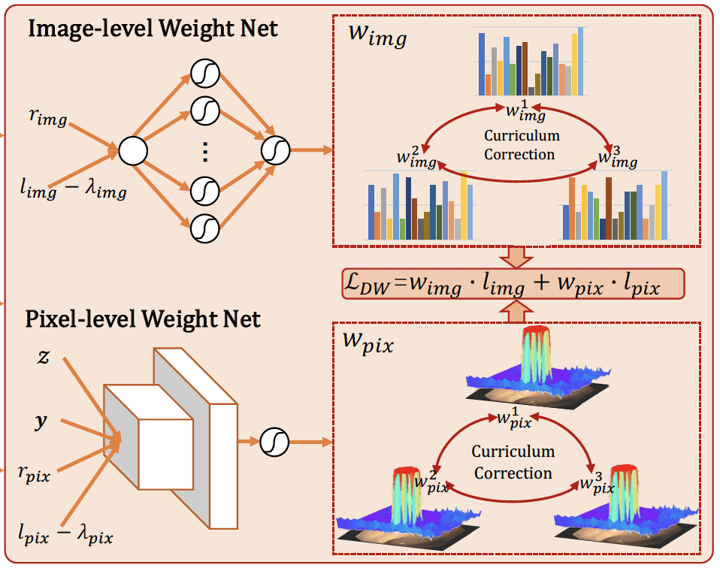
Introduction
Existing approaches:
Resampling and reweighting strategy [1]
[1] Guo, X., Chen, Z., Liu, J., Yuan, Y. Non-equivalent images and pixels: Confidence-aware resampling with meta-learning mixup for polyp segmentation. Medical Image Analysis, 78, 102394, (2022).
Notes:
\\Firstly, pixel-wise resampling and reweighting strategies are designed to concentrate the segmentation model on learning reliable pixels.

Slide 6
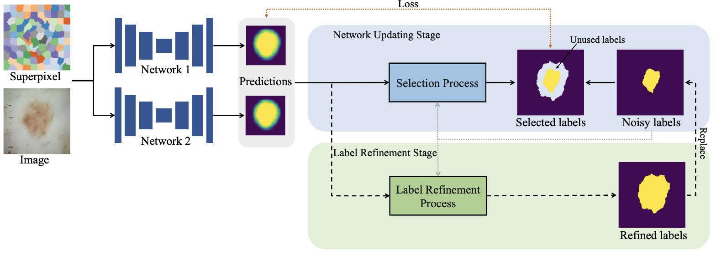
Introduction
Existing approaches:
Resampling and reweighting strategy [1]
Label Correction [2]
[1] Guo, X., Chen, Z., Liu, J., Yuan, Y. Non-equivalent images and pixels: Confidence-aware resampling with meta-learning mixup for polyp segmentation. Medical Image Analysis, 78, 102394, (2022).
[2] Li, S., Gao, Z., He, X.: Superpixel-guided iterative learning from noisy labels for medical image segmentation. In: MICCAI. pp. 525–535. Springer (2021)
Notes:
\\Secondly, pixel-wise label correction is implemented to refurbish noisy labels.

Slide 7
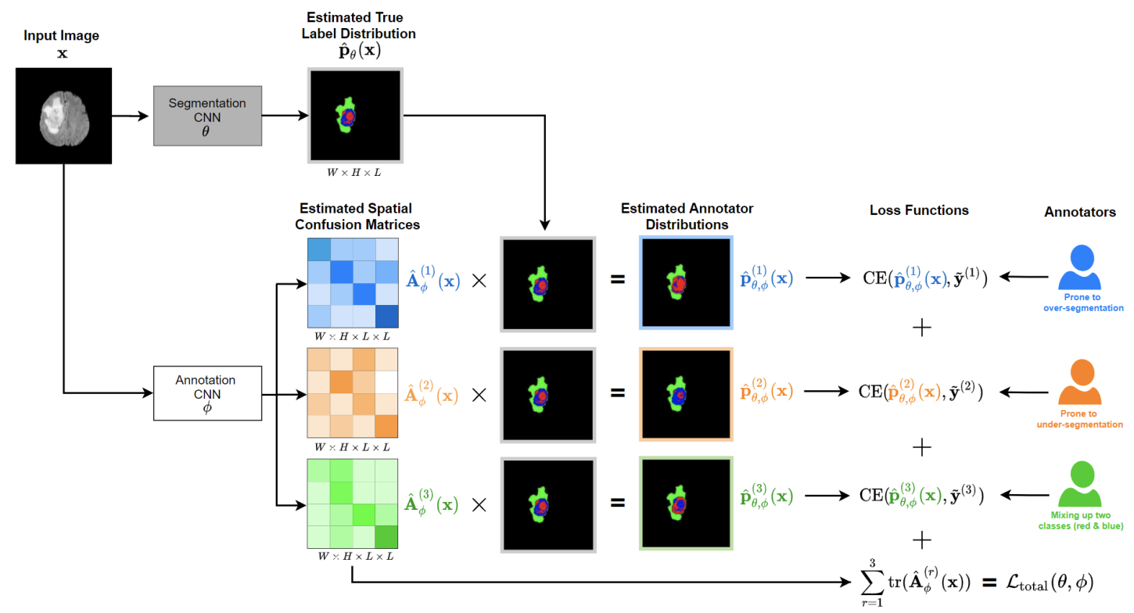
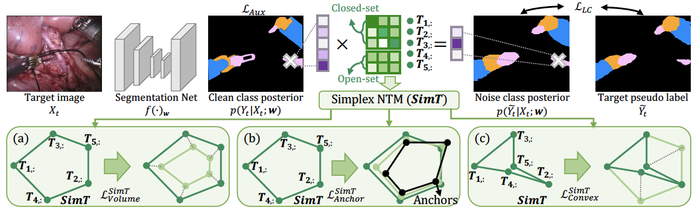
Introduction
Existing approaches:
Resampling and reweighting strategy [1]
Label Correction [2]
Loss correction w/ confusion matrix [3]
Loss correction w/ noise transition matrix (NTM) [4]
[1] Guo, X., Chen, Z., Liu, J., Yuan, Y. Non-equivalent images and pixels: Confidence-aware resampling with meta-learning mixup for polyp segmentation. Medical Image Analysis, 78, 102394, (2022).
[2] Li, S., Gao, Z., He, X.: Superpixel-guided iterative learning from noisy labels for medical image segmentation. In: MICCAI. pp. 525–535. Springer (2021)
[3] Zhang, L., Tanno, et al., Alexander, D.: Disentangling human error from ground truth in segmentation of medical images. NeurIPS 33, 15750–15762 (2020)
[4] Guo, X., Liu, J., Liu, T., Yuan, Y.: Simt: Handling open-set noise for domain adaptive semantic segmentation. In: CVPR (2022)
Notes:
\\Thirdly, some researchers model the noisy label distribution through either the confusion matrix [20] or noise transition matrix (NTM) [6,7], and then leverage the modeled distribution for pixel-wise loss corrections.

Slide 8
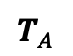
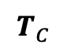
Motivation
Motivation
The pair-wise manner reduces label noise rate
0
0
1
0
1
1
2/3
1/3
1
2
2
2
2
3
1/2
1/2
$$T_{C}$$
1/2
1/2
3
3
0
3
0
0
1/2
Clean label
Noisy label
Class-level NTM
1
1
0
0
0
0
0
1
0
0
1
0
0
0
0
0
0
1
1
1
1
0
0
0
0
0
0
1
0
1
1
0
0
0
0
0
0
0
0
1
1
0
0
0
0
0
0
1
1
0
0
0
0
0
0
0
0
1
1
0
0
0
0
0
0
0
0
1
1
0
0
0
0
11/20
9/20
$$T_{A}$$
0
0
0
0
1
1
0
0
0
0
0
0
1
1
0
0
0
0
10/61
50/61
0
0
0
0
1
1
0
0
0
0
0
0
0
0
1
1
0
0
Affinity-level NTM
0
0
0
0
0
0
1
1
0
0
0
0
0
0
1
1
0
0
0
0
0
0
0
0
1
1
0
1
0
0
0
0
0
0
1
1
1
1
0
0
0
0
0
0
1
1
0
0
0
0
0
0
1
1
Clean affinity label
Noisy affinity label
[Guo and Yuan MICCAI 2022]
Motivation
Notes:
Despite the impressive performance, almost all existing image segmentation methods tackle label noise issues merely in a pixel-wise manner.
In this work, we found that the pair-wise manner can greatly reduce the noise rate.

Slide 9
Motivation
Motivation
The pair-wise manner reduces label noise rate
0
0
1
0
1
1
2/3
1/3
1
2
2
2
2
3
1/2
1/2
$$T_{C}$$
1/2
1/2
3
3
0
3
0
0
1/2
Clean label
Noisy label
Class-level NTM
1
1
0
0
0
0
0
1
0
0
1
0
0
0
0
0
0
1
1
0
0
1
1
0
0
0
0
0
0
1
0
1
1
0
0
0
0
0
0
0
0
1
1
0
0
0
0
0
0
1
1
0
0
0
0
0
0
0
0
1
1
0
0
0
0
0
0
0
0
1
1
0
0
0
0
11/20
9/20
$$T_{A}$$
0
0
0
0
1
1
0
0
0
0
0
0
1
1
0
0
0
0
10/61
50/61
0
0
0
0
1
1
0
0
0
0
0
0
0
0
1
1
0
0
Affinity-level NTM
0
0
0
0
0
0
1
1
0
0
0
0
0
0
1
1
0
0
0
0
0
0
0
0
1
1
0
1
0
0
0
0
0
0
1
1
1
1
0
0
0
0
0
0
1
1
0
0
0
0
0
0
1
1
Clean affinity label
Noisy affinity label
[Guo and Yuan MICCAI 2022]
Motivation
Notes:
\\ For example, if one pixel in a pair is mislabeled or

Slide 10
Motivation
Motivation
The pair-wise manner reduces label noise rate
0
0
1
0
1
1
2/3
1/3
1
2
2
2
2
3
1/2
1/2
$$T_{C}$$
1/2
1/2
3
3
0
3
0
0
1/2
Clean label
Noisy label
Class-level NTM
1
1
0
0
0
0
0
1
0
0
1
0
0
0
0
0
0
1
1
0
0
1
1
0
0
0
0
0
0
1
0
1
1
0
0
0
0
0
0
0
0
0
0
1
1
0
0
0
0
0
0
1
1
0
0
0
0
0
0
0
0
1
1
0
0
0
0
0
0
0
0
1
1
0
0
0
0
11/20
9/20
$$T_{A}$$
0
0
0
0
1
1
0
0
0
0
0
0
1
1
0
0
0
0
10/61
50/61
0
0
0
0
1
1
0
0
0
0
0
0
0
0
1
1
0
0
Affinity-level NTM
0
0
0
0
0
0
1
1
0
0
0
0
0
0
1
1
0
0
0
0
0
0
0
0
1
1
0
1
0
0
0
0
0
0
1
1
1
1
0
0
0
0
0
0
1
1
0
0
0
0
0
0
1
1
Clean affinity label
Noisy affinity label
[Guo and Yuan MICCAI 2022]
Motivation
Notes:
\\ even both pixels are mislabeled, the affinity label of this pair might be correct,

Slide 11
Motivation
Motivation
The pair-wise manner reduces label noise rate
0
0
1
0
1
1
2/3
1/3
1
2
2
2
2
3
1/2
1/2
$$T_{C}$$
1/2
1/2
3
3
0
3
0
0
1/2
Clean label
Noisy label
Class-level NTM
1
1
0
0
0
0
0
1
0
Noise rate:
44%
0
1
0
0
0
0
0
0
1
1
0
0
1
1
0
0
0
0
0
0
1
0
1
1
0
0
0
0
0
0
0
0
0
0
1
1
0
0
0
0
0
0
1
1
0
0
0
0
0
0
0
0
1
1
0
0
0
0
0
0
0
0
1
1
0
0
0
0
11/20
9/20
$$T_{A}$$
0
0
0
0
1
1
0
0
0
0
0
0
1
1
0
0
0
0
10/61
50/61
0
0
0
0
1
1
0
0
0
0
0
0
0
0
1
1
0
0
Affinity-level NTM
0
0
0
0
0
0
1
1
0
0
0
0
0
0
1
1
0
0
Noise rate:
23%
0
0
0
0
0
0
1
1
0
1
0
0
0
0
0
0
1
1
1
1
0
0
0
0
0
0
1
1
0
0
0
0
0
0
1
1
Clean affinity label
Noisy affinity label
[Guo and Yuan MICCAI 2022]
Motivation
Notes:
thereby reducing the noise rate from 44% to 23%.

Slide 12
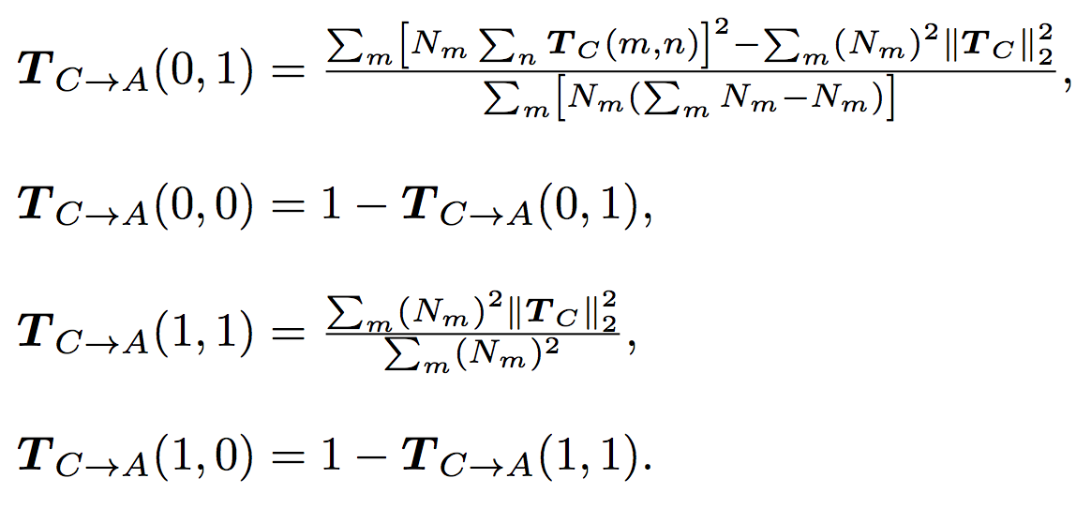
Motivation
Motivation
The pair-wise manner reduces label noise rate
0
0
1
0
1
1
2/3
1/3
1
2
2
2
2
3
1/2
1/2
$$T_{C}$$
1/2
1/2
3
3
0
3
0
0
1/2
Clean label
Noisy label
Class-level NTM
1
1
0
0
0
0
0
1
0
Noise rate:
44%
0
1
0
0
0
0
0
0
1
1
0
0
1
1
0
0
0
0
0
0
1
0
1
1
0
0
0
0
0
0
0
0
0
0
1
1
0
0
0
0
0
0
1
1
0
0
0
0
0
0
0
0
1
1
0
0
0
0
0
0
0
0
1
1
0
0
0
0
11/20
9/20
$$T_{A}$$
0
0
0
0
1
1
0
0
0
0
0
0
1
1
0
0
0
0
10/61
50/61
0
0
0
0
1
1
0
0
0
0
0
0
0
0
1
1
0
0
Affinity-level NTM
0
0
0
0
0
0
1
1
0
0
0
0
0
0
1
1
0
0
Noise rate:
23%
0
0
0
0
0
0
1
1
0
1
0
0
0
0
0
0
1
1
1
1
0
0
0
0
0
0
1
1
0
0
0
0
0
0
1
1
Clean affinity label
Noisy affinity label
[Guo and Yuan MICCAI 2022]
Motivation
Notes:
\\Moreover, we found there is a mathematical relationship between the class-level and affinity-level NTM, as this formulations.

Slide 13
Motivation
Motivation
The pair-wise manner reduces label noise rate
Unify the pixel-wise and pair-wise manners
0
0
1
0
1
1
2/3
1/3
1
2
2
2
2
3
1/2
1/2
$$T_{C}$$
1/2
1/2
3
3
0
3
0
0
1/2
Clean label
Noisy label
Class-level NTM
1
1
0
0
0
0
0
1
0
Noise rate:
44%
0
1
0
0
0
0
0
0
1
1
0
0
1
1
0
0
0
0
0
0
1
0
1
1
0
0
0
0
0
0
0
0
0
0
1
1
0
0
0
0
0
0
1
1
0
0
0
0
0
0
0
0
1
1
0
0
0
0
0
0
0
0
1
1
0
0
0
0
11/20
9/20
$$T_{A}$$
0
0
0
0
1
1
0
0
0
0
0
0
1
1
0
0
0
0
10/61
50/61
0
0
0
0
1
1
0
0
0
0
0
0
0
0
1
1
0
0
Affinity-level NTM
0
0
0
0
0
0
1
1
0
0
0
0
0
0
1
1
0
0
Noise rate:
23%
0
0
0
0
0
0
1
1
0
1
0
0
0
0
0
0
1
1
1
1
0
0
0
0
0
0
1
1
0
0
0
0
0
0
1
1
Clean affinity label
Noisy affinity label
[Guo and Yuan MICCAI 2022]
Motivation
Notes:
\\Therefore, we unify the pixel-wise and pair-wise manners and propose a joint class-affinity loss correction framework to combat label noise issues.

Slide 14
Motivation
Motivation
The pair-wise manner reduces label noise rate
Unify the pixel-wise and pair-wise manners
The first effort in exploiting the affinity relation between pixels within an image for noisy mitigation
0
0
1
0
1
1
2/3
1/3
1
2
2
2
2
3
1/2
1/2
$$T_{C}$$
1/2
1/2
3
3
0
3
0
0
1/2
Clean label
Noisy label
Class-level NTM
1
1
0
0
0
0
0
1
0
Noise rate:
44%
0
1
0
0
0
0
0
0
1
1
0
0
1
1
0
0
0
0
0
0
1
0
1
1
0
0
0
0
0
0
0
0
0
0
1
1
0
0
0
0
0
0
1
1
0
0
0
0
0
0
0
0
1
1
0
0
0
0
0
0
0
0
1
1
0
0
0
0
11/20
9/20
$$T_{A}$$
0
0
0
0
1
1
0
0
0
0
0
0
1
1
0
0
0
0
10/61
50/61
0
0
0
0
1
1
0
0
0
0
0
0
0
0
1
1
0
0
Affinity-level NTM
0
0
0
0
0
0
1
1
0
0
0
0
0
0
1
1
0
0
Noise rate:
23%
0
0
0
0
0
0
1
1
0
1
0
0
0
0
0
0
1
1
1
1
0
0
0
0
0
0
1
1
0
0
0
0
0
0
1
1
Clean affinity label
Noisy affinity label
[Guo and Yuan MICCAI 2022]
Motivation
Notes:
To my best knowledge, we made the first effort in exploiting the affinity relation between pixels within an image for noisy mitigation in a pair-wise manner.

Slide 15
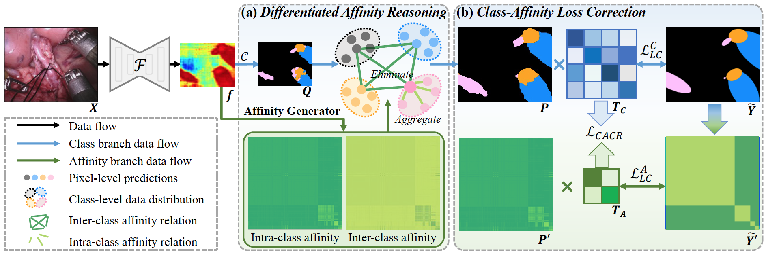
Method
Our approach: Joint Class-Affinity Loss Correction (JCAS)
Pixel-wise supervision signal derived from class label preserves semantics
Pair-wise supervision signal derived from affinity label reduces noise rate
[Guo and Yuan MICCAI 2022]
Method
Notes:
Pixel-wise and pair-wise manners are complementary to each other because the pixel-wise one preserves semantics and the pairwise one reduces noise rate.

Slide 16
Method
Our approach: Joint Class-Affinity Loss Correction (JCAS)
Pixel-wise supervision signal derived from class label preserves semantics
Pair-wise supervision signal derived from affinity label reduces noise rate
Differentiated affinity reasoning (DAR) module
[Guo and Yuan MICCAI 2022]
Method
Notes:
\\Moreover, we devise a DAR module to guide the refinement of pixel-wise predictions with differentiated pair-wise affinities. This module differentiates affinity relations to explicitly aggregate intra-class correlated information and eliminate inter-class irrelevant information.

Slide 17
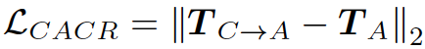
Method
Our approach: Joint Class-Affinity Loss Correction (JCAS)
Pixel-wise supervision signal derived from class label preserves semantics
Pair-wise supervision signal derived from affinity label reduces noise rate
Differentiated affinity reasoning (DAR) module
Class-affinity loss correction (CALC) strategy
[Guo and Yuan MICCAI 2022]
Method
Notes:
\\To further correct both pixel and pair-wise supervision signals, we design a CALC strategy. This strategy models noise distributions in class labels and affinity labels as two NTM for loss correction. In the meanwhile, we unify the pixel- and pair-wise supervisions through the previously derived consistency regularization, thereby facilitating the noise resistance.

Slide 18
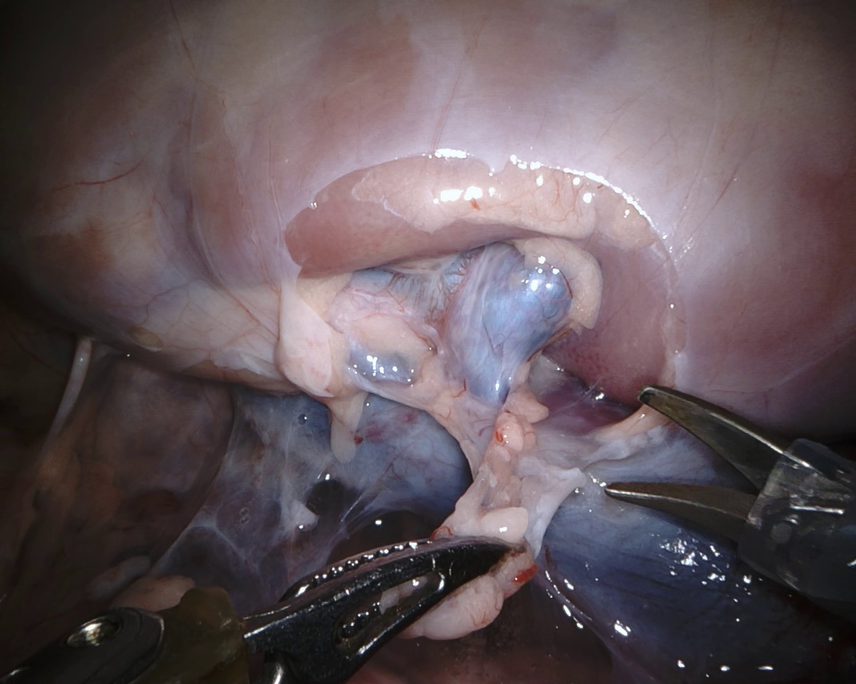
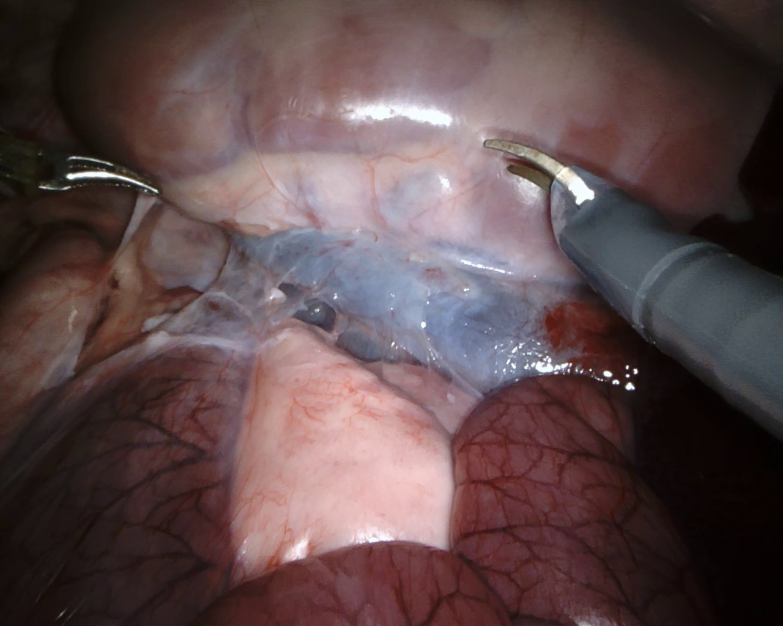
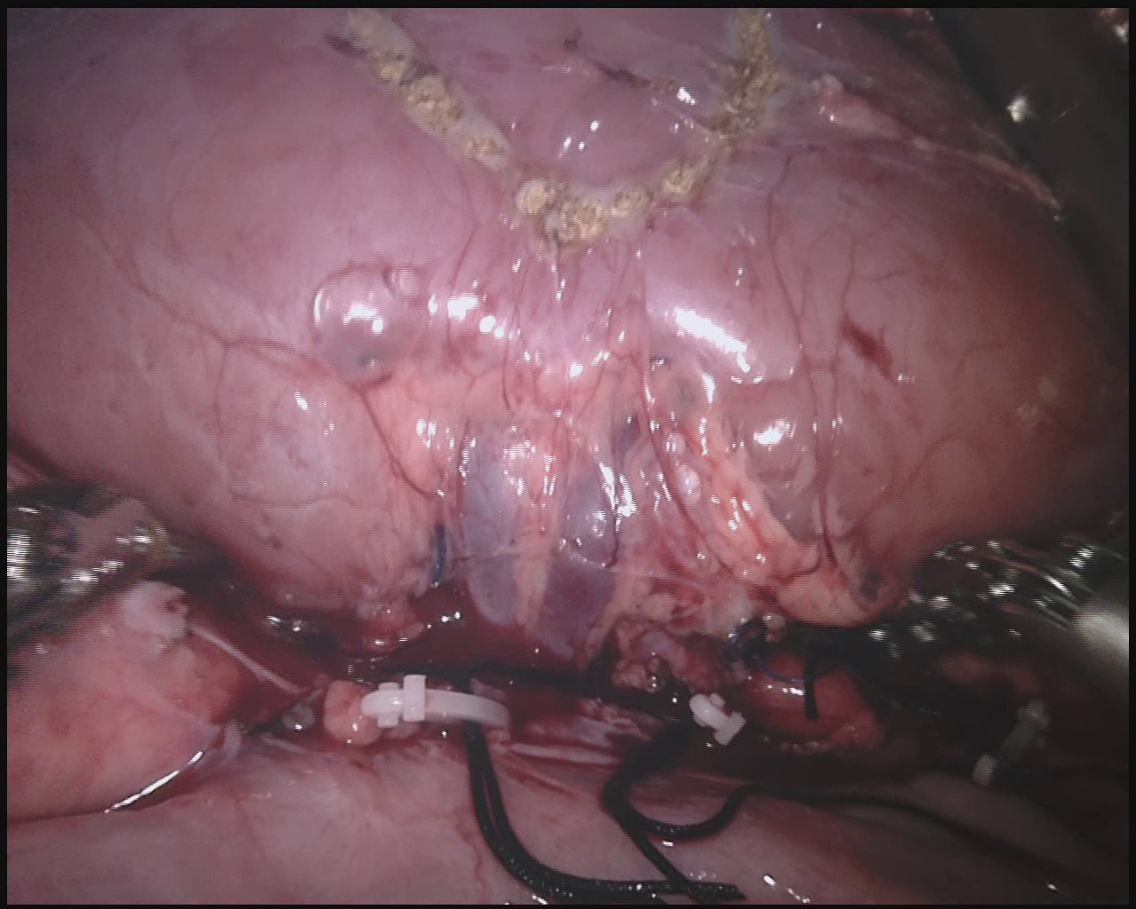
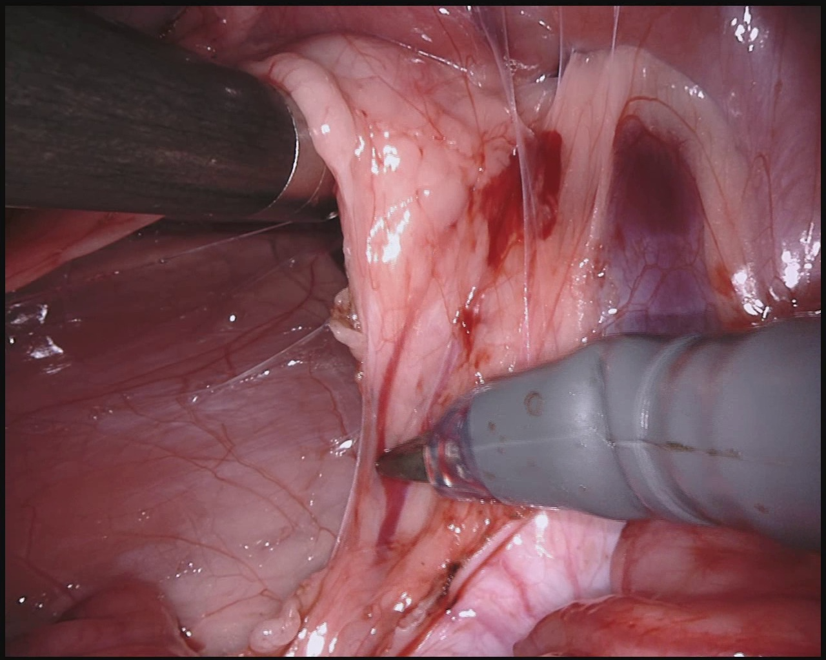
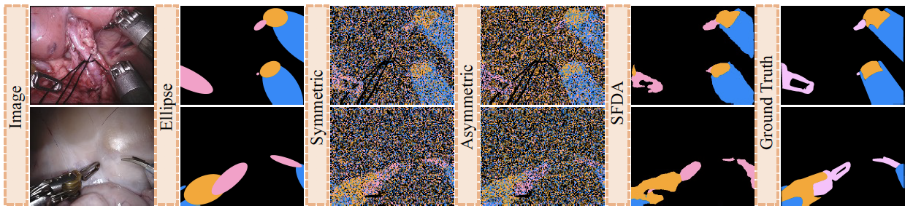
Experiment
Datasets:
Endovis18: 2235 images (1639 training images & 596 test images)
3 instrument part classes (shaft, wrist and clasper classes)
Noise patterns:
synthetic label noise (elipse, symmetric and asymmetric noises)
real-world label noise (noisy pseudo labels in source-free domain adaptation (SFDA))
Evaluation metrics:
𝐷𝑖𝑐𝑒, 𝐽𝑎𝑐 per class
[Guo and Yuan MICCAI 2022]
Experiment
Notes:
we apply the proposed JCAS framework on a public dataset for surgical instrument part segmentation, including 3 classes.
we conduct experiments under four kinds of label noises, including elipse, symmetric, asymmetric, and SFDA label noises. Especially, the elipse label noise is like a kind of week supervision, and the SFDA noise is common in learning from cross-domain data.

Slide 19
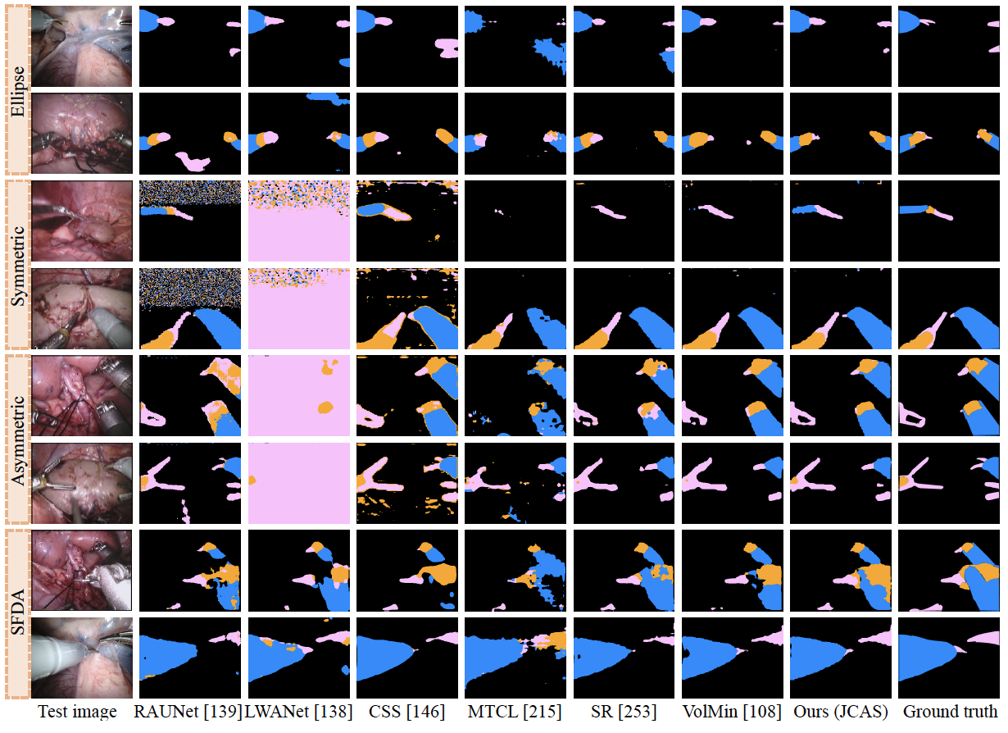
Experiment
Experimental results
Superior to state-of-the-art methods
[Guo and Yuan MICCAI 2022]
Experiment
Notes:
We compare the proposed JCAS framework with three state-of-the-art surgical instrument segmentation methods, and

Slide 20
Experiment
Experimental results
Superior to state-of-the-art methods
[Guo and Yuan MICCAI 2022]
Experiment
Notes:
\\three label noise methods.

Slide 21
Experiment
Experimental results
Superior to state-of-the-art methods
[Guo and Yuan MICCAI 2022]
Experiment
Notes:
We can observe that our method shows superior performance in all types of label noises.

Slide 22
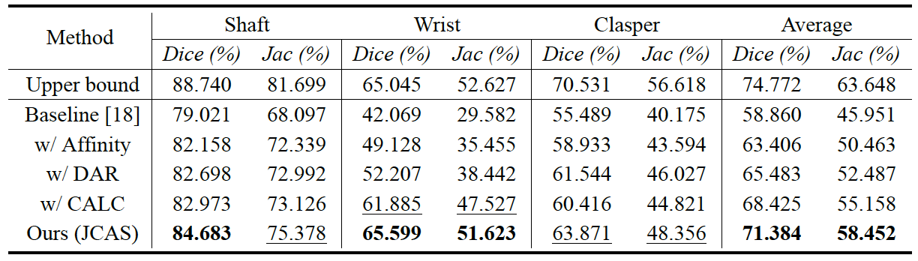
Experiment
Experimental results
Ablation study under ellipse label noise
[Guo and Yuan MICCAI 2022]
Experiment
Notes:
Then I conduct ablation study under ellipse label noise.

Slide 23
Experiment
Experimental results
Ablation study under ellipse label noise
Curve of test 𝐽𝑎𝑐 vs. epoch with four different types of noise labels
[Guo and Yuan MICCAI 2022]
Experiment
Notes:
With the introduction of pair-wise manner (‘w/ Affinity’), the noise rate is greatly reduced, yielding a significant improvement.

Slide 24
Experiment
Experimental results
Ablation study under ellipse label noise
[Guo and Yuan MICCAI 2022]
Experiment
Notes:
\\The devised DAR module is also verified to be effective in the refinement of pixel-wise predictions.

Slide 25
Experiment
Experimental results
Ablation study under ellipse label noise
[Guo and Yuan MICCAI 2022]
Experiment
Notes:
Moreover, our CALC strategy further rectifies supervision signals and boosts the performance.

Slide 26
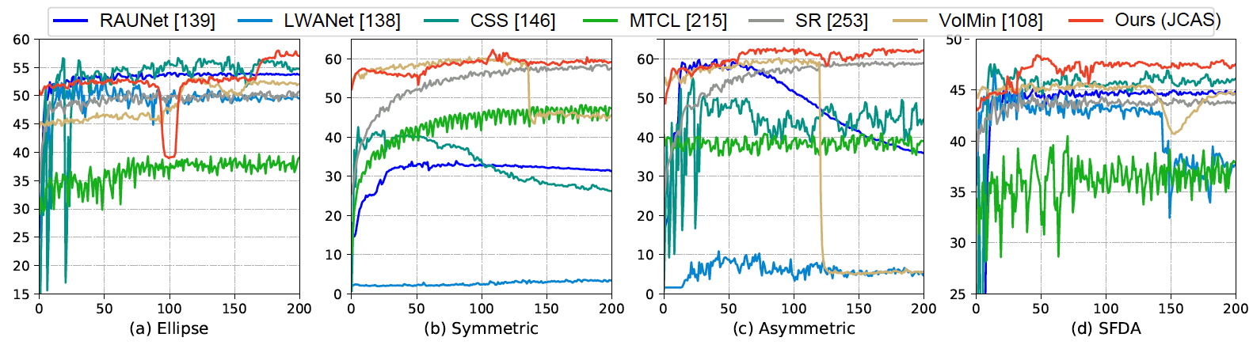
Experiment
Experimental results
Ablation study under ellipse label noise
Curve of test 𝐽𝑎𝑐 vs. epoch with four different types of noise labels
[Guo and Yuan MICCAI 2022]
Experiment
Notes:
I also show test accuracy curves during training stage. Some baselines reach a high score in the early stage and then decrease. In contrast, our method converges to high performance, verifying its noise-resistant property.

Slide 27

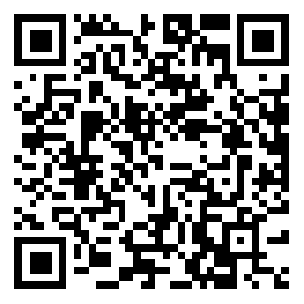
Thanks!
Emails:
xqguo.ee@my.cityu.edu.hk
Paper
Code
Notes:
Thanks for listening to our presentation, and welcome to access our code on github.

